Slide 1
Next time: the logic of “there must be an alternative” is still way challenging for students
Used example: should I conclude April Fool’s joke if all students are wearing bright green hats with pink tassels?
Should I conclude if all students come in with clothes on?
Why/why not? b/c one is NOTABLE b/c there was many alternatives. One is NOT notable, b/c relatively speaking, no alternative

Slide 2
A word on words
DNA sequence: The exact series of bases in a given stretch of DNA. Examples might be
GGAGAGAGATCCTA
CCACACGATCGATCGATC
CTGCTGCTGAAAGAGAAA
Amino acid sequence the same, but names the amino acids in a stretch of protein

Slide 3
Why we look different
Yup, it’s ‘genes’

Slide 4
mutatis mutandis*
Whence blue eyes?
What’s a ‘good’ gene? Where do new ones come from?
*According to dictionary.com: the necessary changes have been made

Slide 5
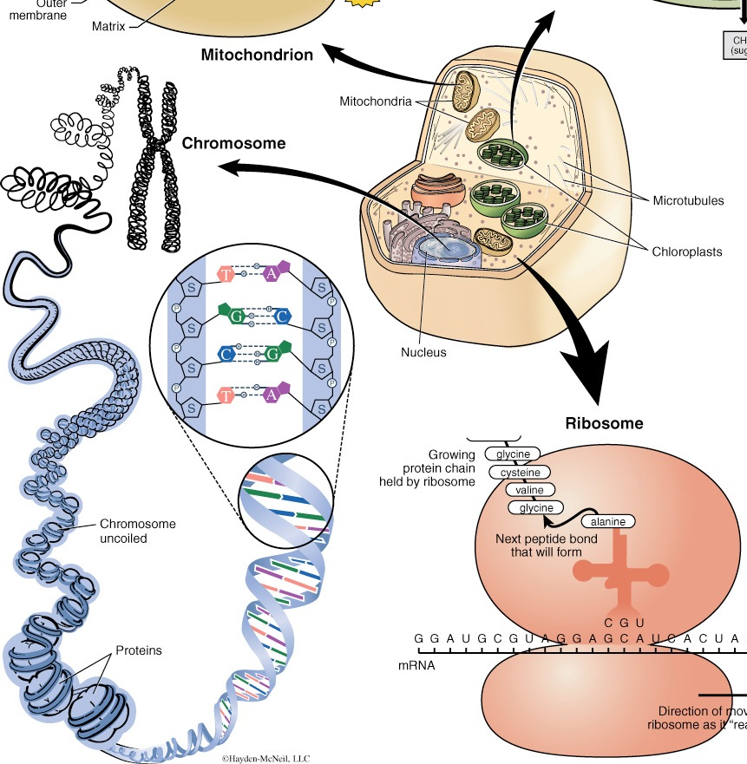
Scaling & words: Familiarize
A gene is ~1,000-100,000 basepairs*
An allele is a particular gene sequence
A genotype refers to the alleles present in a given genome
A genome is 1-100s of chromosomes
A chromosome is tens or hundreds of thousands of genes
A human genome is ~3,000,000,000 basepairs
the human genome is (currently guesstimated at) ~20-30,000 genes**
A human genome is ~1 meter of DNA
*Includes control regions & stuff that won’t make it into the final product
**We keep finding stuff that matters
Notes:
They keep discovering smaller & smaller functional RNAs, so the gene count is headed up again

Slide 6
Mutations matter
Source: damnyouautocorrect.com
Warning: frank language & annoying site design
Notes:
Many MANY changes to sequence have no detectable consequence whatsoever
Some do...

Slide 7
Concept: asymmetry
Which is more likely: a mutation that causes a protein (say, lac repressor) to bind DNA better or bind more weakly?
Hint: I take a hammer to your car. Odds of improvement?
Asterisk: some biological machines are NOT optimized to be as fast, strong, etc.
lac promoter is one
otherwise, it wouldn’t benefit from the help of activator
we will meet others
Notes:
An enzyme is an incredibly fine-tuned machine
Consider ATPase we examined (yes, you STILL need mastery of that—and will need it explicitly in coming weeks!)
Water needs to be held just so—and the sidechains holding it must be there
Each phosphate oxygen needs comforting—but in the transition state, not before!
The whole thing must SELF-fold!

Slide 8
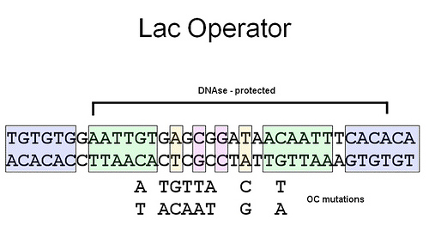
Repressor interrupted... permanently
Changes below the line ‘ruin’ the DNA site--render it ‘unpalatable’ to the repressor protein such that it no longer binds
EACH of the changes shown prevents binding
http://wiki.cstl.semo.edu/agathman/Print.aspx?Page=Prokaryotic%20Gene%20Regulation%20Powerpoint
Notes:
Evidence. When these DNA changes are made, the lac enzyme production cannot be turned off

Slide 9
Mutants among us
Blue eyes stand up. Green too
Congratulations. You’re mutants
Mutation is a good thing? Apparently blue eyes are worthwhile
why might this be given that blue eyes increase risk of cataracts?*
*Transactions of the American Ophthalmological Society 98:109-117 (2000)
Notes:
The ARGUMENT that blue-eyed people are mutant derivatives of brown-eyed ones has several components
—One is which is the most DIVERSE (has had the longest to accumulate changes)
—Two is that blue eyed people are ‘all the same’ genetically
— < 10,000 years old

Slide 10
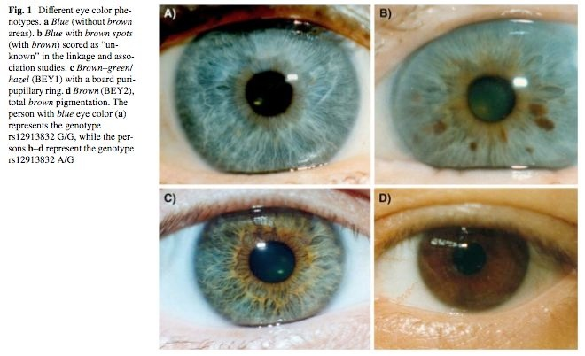
Seeing eyes
Notes:
Single nucleotide change
NOTE!!! They extrapolate from hundreds of families in Denmark, + a few in Turkey, + a few in Jordan
FYI--each of us carries an estimated 200 novel mutations (changes in DNA sequence; not necessarily CONSEQUENTIAL changes!!!!!)
BROWN dominant to blue. At a second locus, IF not brown, green dominates blue

Slide 11
Terminology & eyes
What is the MEANING of ‘brown eyes are dominant’?
Why should that be so? What do brown alleles got that blue do not?
Notes:
Short form: Brown allele ‘wins’ causing brown-ness even when blue allele present
REASON: Brown allele specifies making brown gunk (melanin; the primary pigment in skin, eye, hair color); blue allele fails to specify the making of gunk. Any brown gunk = brown; only NO gunk = blue

Slide 12
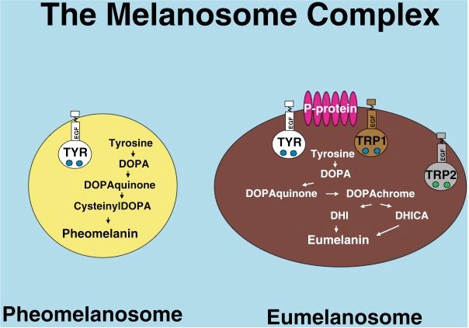
Making brown
Vesicles produce, contain pigment
Pheos produce yellow/red pigment
Eus lead to browns/blacks
Source: “Human pigmentation genetics: the difference is only skin deep”
R. A. Sturm, N. F. Box & M. Ramsay
BioEssays 20:712- 721
Notes:
Brown pigment is not a protein

Slide 13
Details, details
http://ukzambians.co.uk/home/wp-content/uploads/2013/07/factpath1.gif
Notes:
Point here is that
melanin not a protein
Many steps in its synthesis-each CARRIED OUT by an enzyme

Slide 14
Getting at the source
Blue-eyed people have the same amino-acid specifying sequence for pigment production as brown-eyed.
Humans have only one primary pigment production pathway that makes melanin, this colors hair, skin, eyes
In other words: the same pathway ‘browns’ eyes & skin
Are blue-eyed people albinos?
Possibilities, please
If it’s not in the coding sequence, then...

Slide 15
Back to birthday cakes
Promoter
Controls
‘regulatory region’
Go!
skin
Product instructions
‘coding sequence’
eyes
A ‘gene’ is…
instructions for what to make (‘coding sequence’
instructions about where, when, how much to make (specified by the regulatory regions)
Changes in any of these can give rise to changes in appearance--phenotype
Notes:
How many things is DNA made of? If you chunk them, it’s all... nucleotides
So the concept of specific places (square, triangle) actual means specific... order & identity of the units (nucleotides--just this once, letters ATGC will be OK, but you are forbidden to think of them that way ever again--take a pledge)

Slide 16
How do blue-eyed freaks of nature arise?
does it keep happening?!?
Notes:
Are you all derived from a single common ancestor?
Or are you separate tribes?

Slide 17
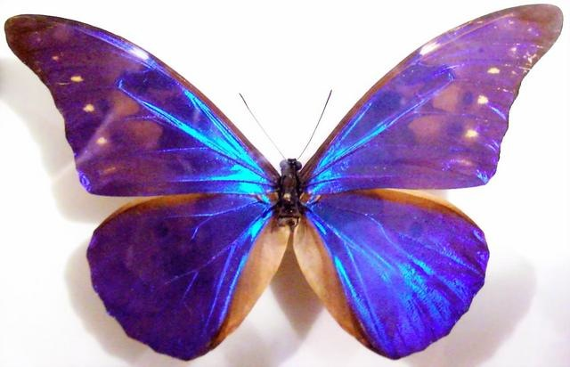
What color is blue?
Brown is brown
Blue is not blue
http://www.asknature.org/strategy/1d00d97a206855365c038d57832ebafa#.UxeAAdzrP7U
Notes:
It’s Physics—related to why the ocean & sky are blue
There are MANY ways to make color—some butterfly wings are colorless, but appear brilliantly

Slide 18
Plagiarism?
Assignment: what are the colors of the rainbow
Finding: All 4 members of Team Awesome mis-spelled a word!
Sam: Violet-Blue-Griin-Yellow-Orange-Red
Sally: Violet-Blue-Green-Yallow-Orange-Red
Sarah: Violet-Bloo-Green-Yellow-Orange-Red
Solomon: Violet-Blue-Green-Yellow-Oringe-Red
Did they plagiarize? What is the basis of your conclusion?
Notes:
Do I have a case? Can I kick ‘em out of the UofA?

Slide 19
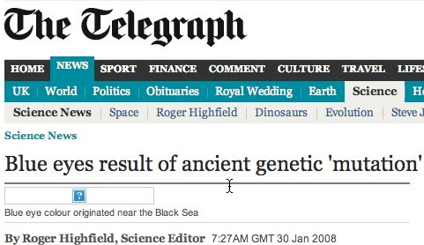
Ripped from the headlines
Question: How is a change in DNA sequence that happened thousands of years ago similar to a mutation?
How is it different?
Blue eye color in humans may be caused by a perfectly
associated founder mutation in a regulatory element located
within the HERC2 gene inhibiting OCA2 expression
Hans Eiberg · Jesper Troelsen · Mette Nielsen ·
Annemette Mikkelsen · Jonas Mengel-From ·
Klaus W. Kjaer · Lars Hansen
Human Genetics (2008) 123:177-87
Notes:
Nope—not ‘mutation’, something similar to a mutation—a mutation. Period. Blue-eyed people are mutants. We must all learn to live with that

Slide 20
Provoking your thoughts
Blue eyes arise from a DNA change that decreases creation of melanin in the eye specifically
Mutation appears identical in all blue-eyed folks, suggesting single origin
On green eyes --they are dominant to blue

Slide 21
Of mice & men
Variety is the spice of mice

Slide 22
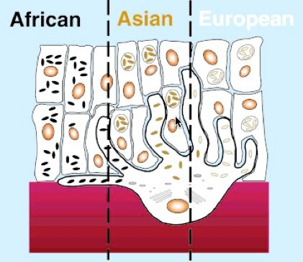
How color is delivered
In African populations, the melanosomes remain as singular heavily pigmented particles while in Asians and Europeans the melanosomes cluster in membrane bound organelles giving different skin complexions.
Source: “Human pigmentation genetics: the difference is only skin deep”
R. A. Sturm, N. F. Box & M. Ramsay
BioEssays 20:712- 721

